Slide 1

HEART ATTACK PREDICTION
Health Technology Development Consultant
H & P
Team Data scientist
1. Hendi Kurniawan
2. Prajudi William Chrisdeardo
03 JULY 2021

Slide 2
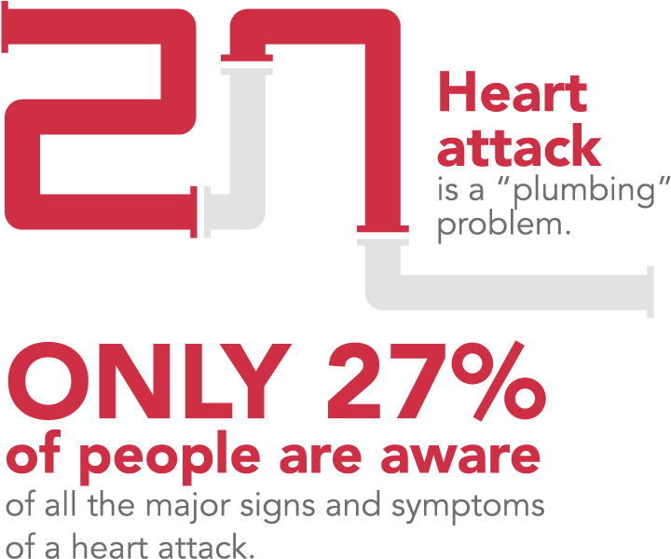
- Motivation -
The accuracy of predicting a disease is very important and requires effective decisions, especially heart attack which is one of the 10 deadliest diseases in the world according WHO. (WHO, 2020)
- Problem Statement -
To find the classification model with the best performance in predicting heart attacks using variables based on diagnosed symptom factors
1

Slide 3

BUSINESS VALUE
Accuracy
Time
Effectiveness
Cost
Medical Treatment
Reputation & Revenue
2

Slide 4
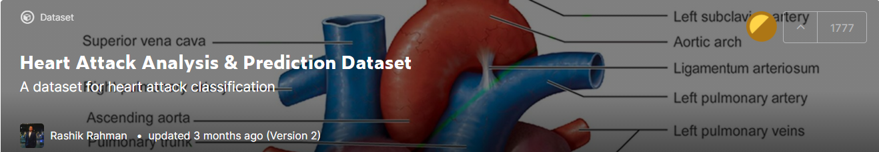
1
DATASETS
2
3
Heart Attact Analysis & Prediction Dataset by Rashik Rahman
Last Updated : 22-03-2021
https://www.kaggle.com/rashikrahmanpritom/heart-attack-analysis-prediction-dataset
303 data observer
14 variable
9 data Factor
5 data Integer
3

Slide 5
1
DATASETS
Factor type variable
2
Numeric type variable
Sex/ Gender
Chest Pain
Fasting Blood Sugar
Resting electrocardiograph
Exercise induced angina
The slope peak excersice ST seg.
Number of mayor vessels
Thallium Stresst test
Output
Age
Resting Blood Pressure
Serum Chorestoral
Maximum Heart Rate
ST Depression Induced by Excersice relative to rest
4

Slide 6
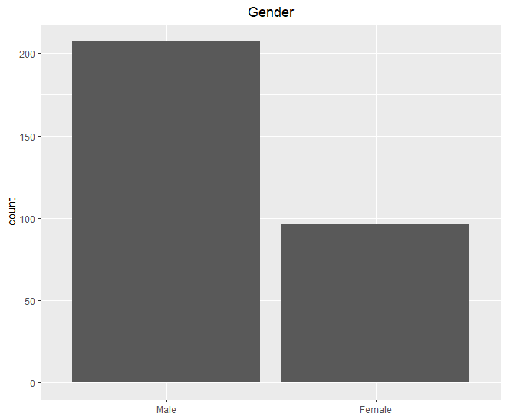
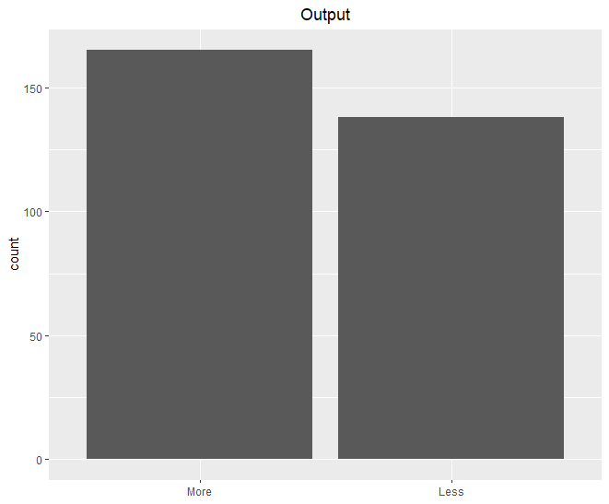
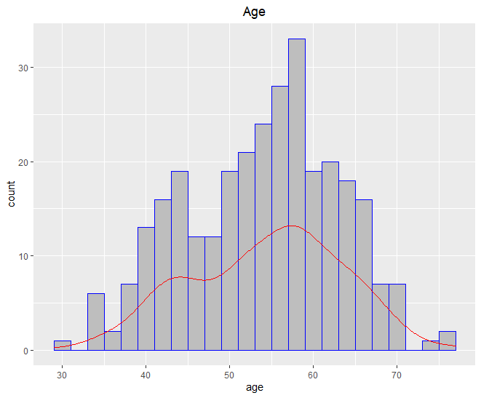
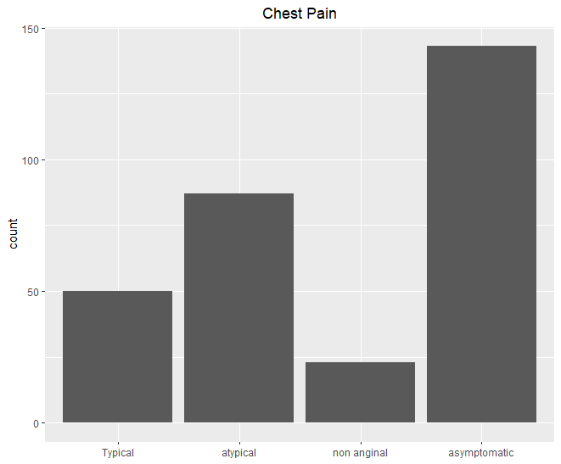
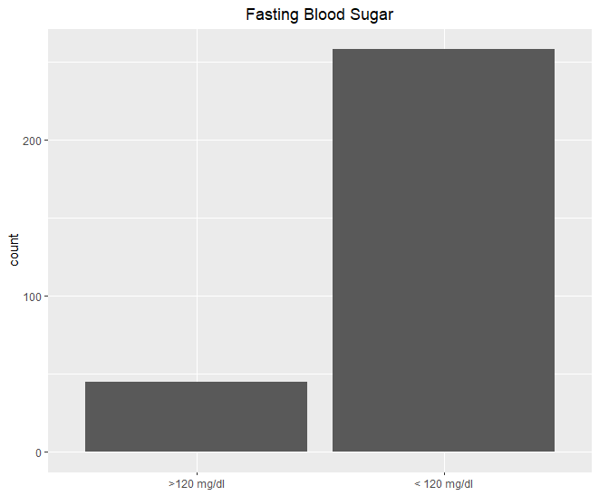
Univariate Analysis
5

Slide 7
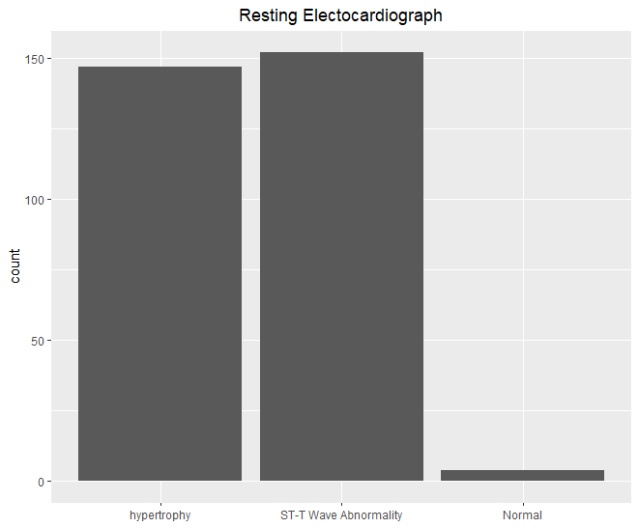
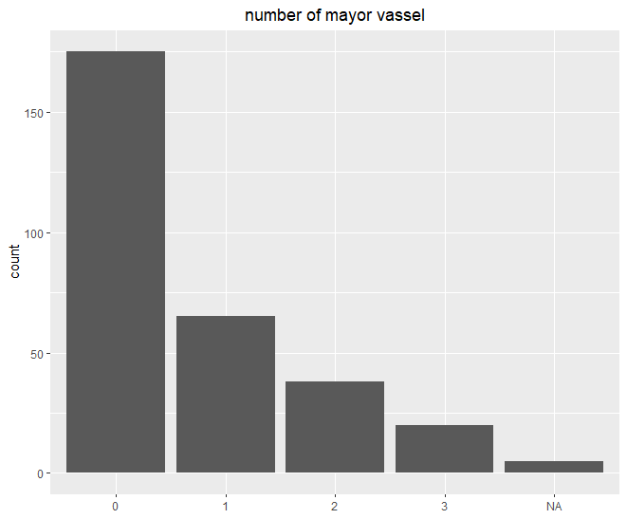
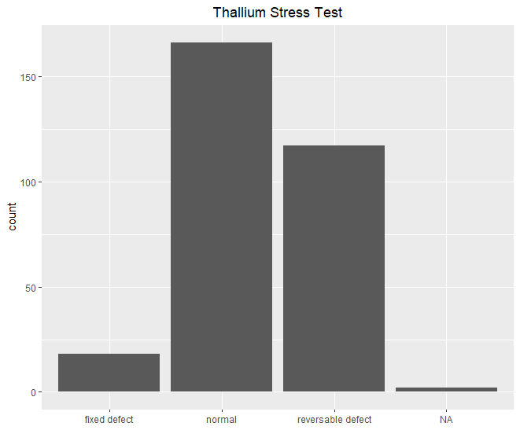
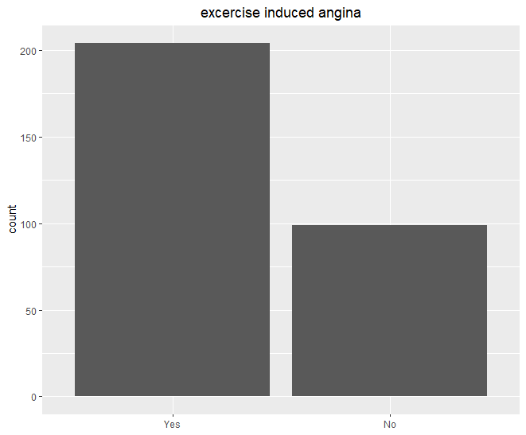
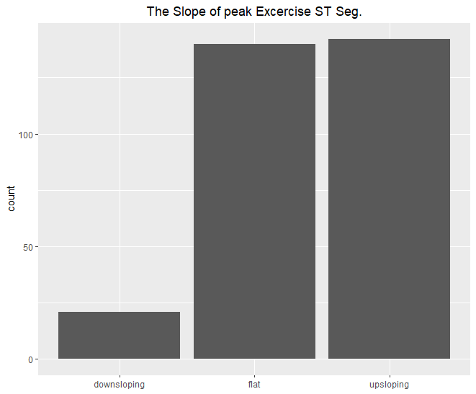
Univariate Analysis
6

Slide 8
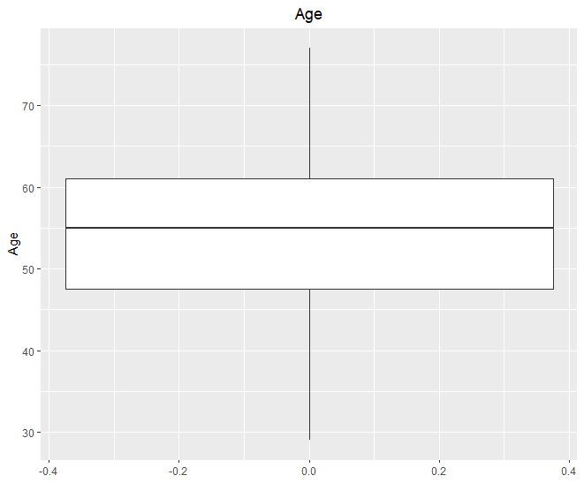
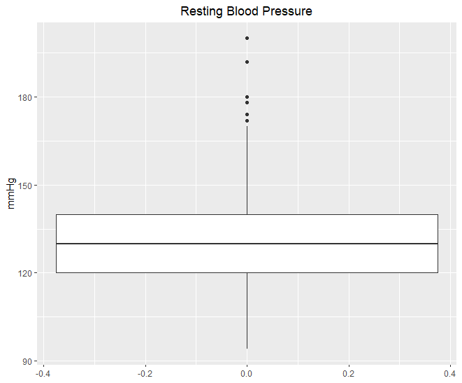
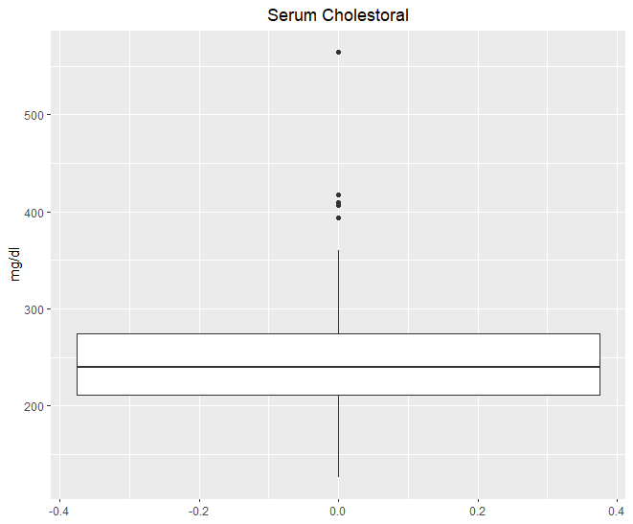
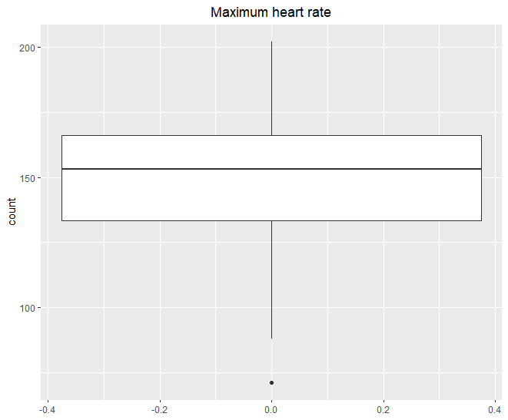
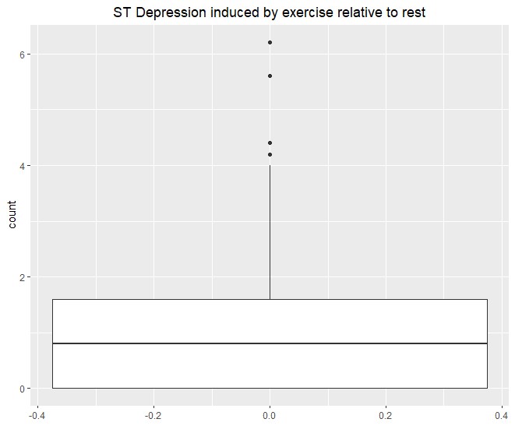
Univariate Analysis
7

Slide 9
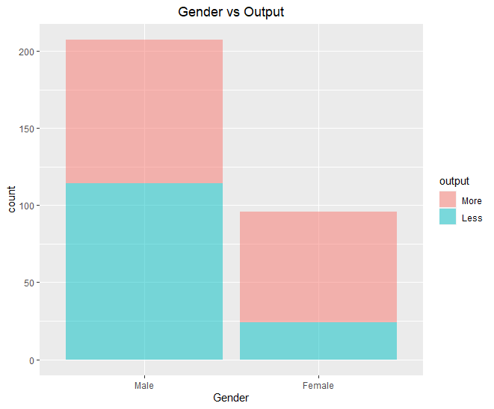
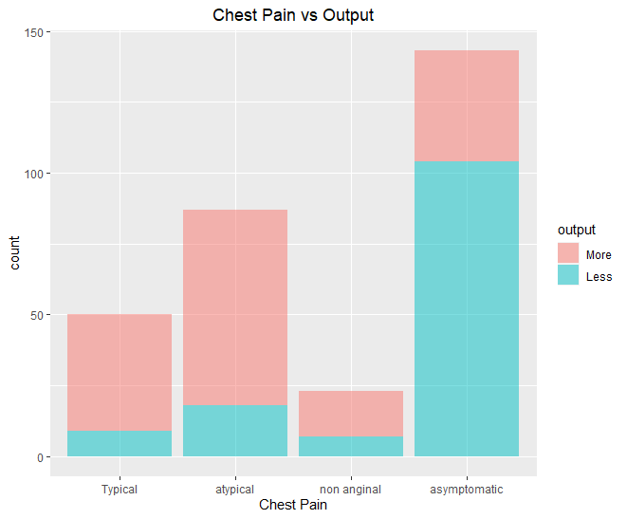
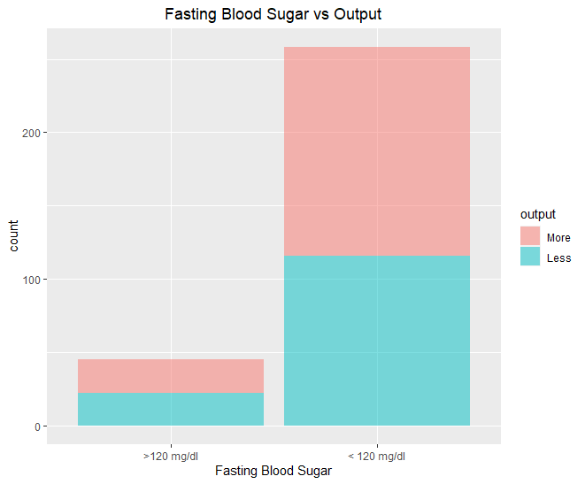
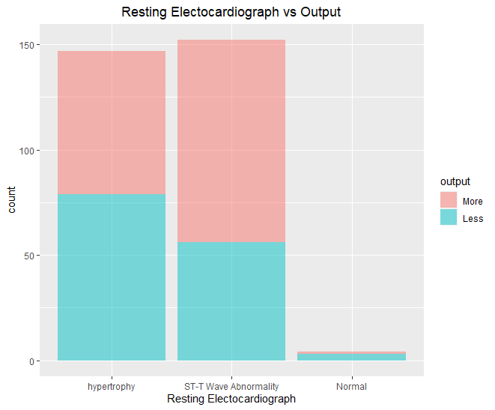
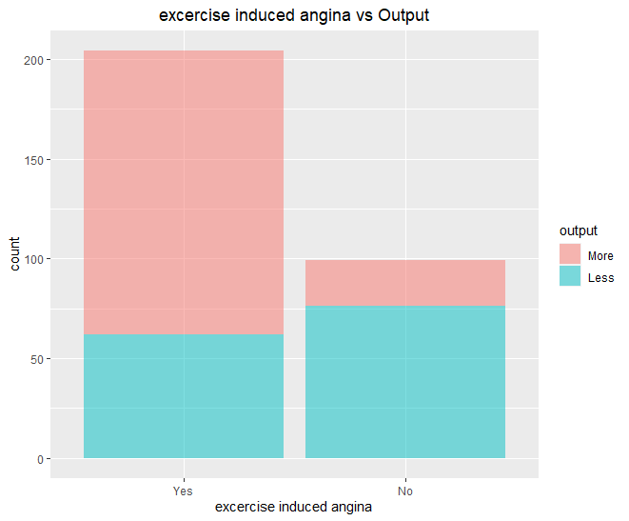
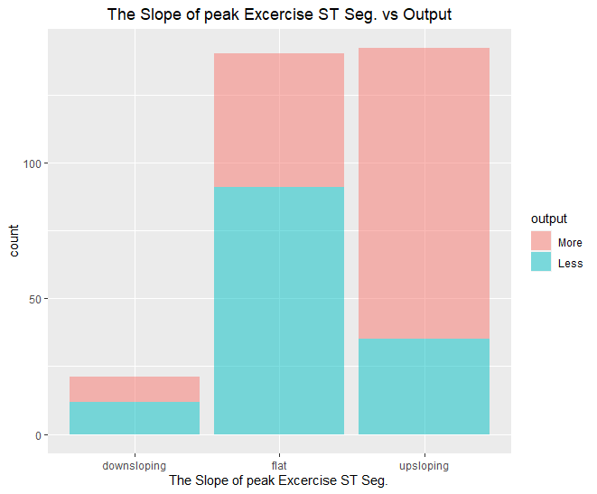
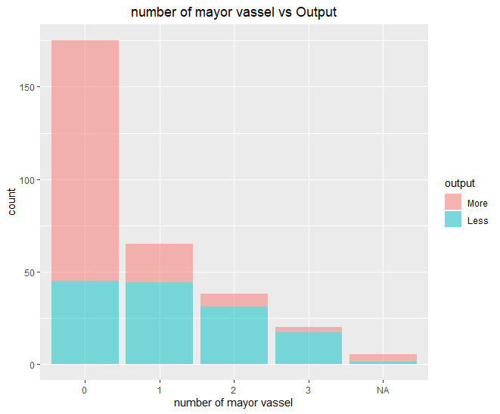
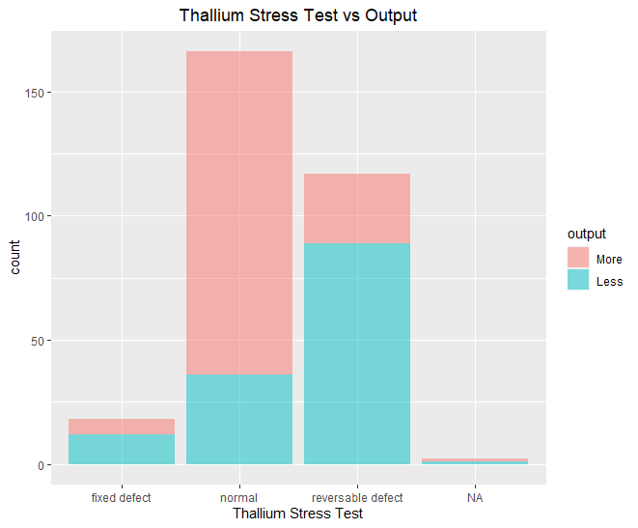
Bivariate Analysis
8

Slide 10
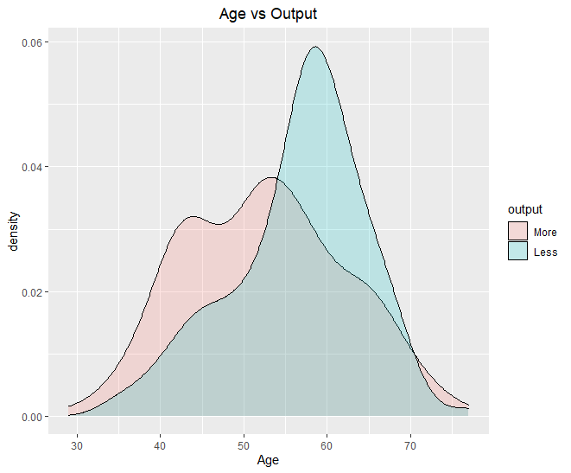
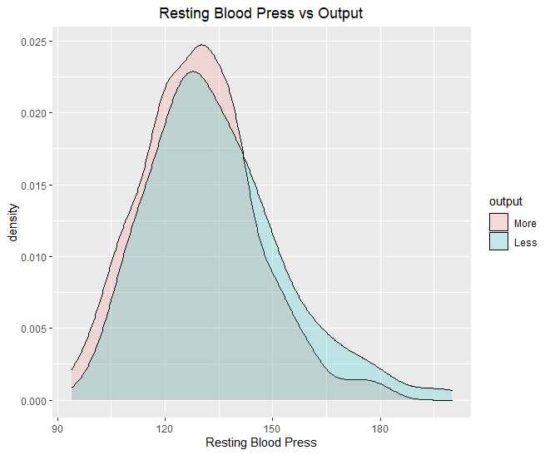
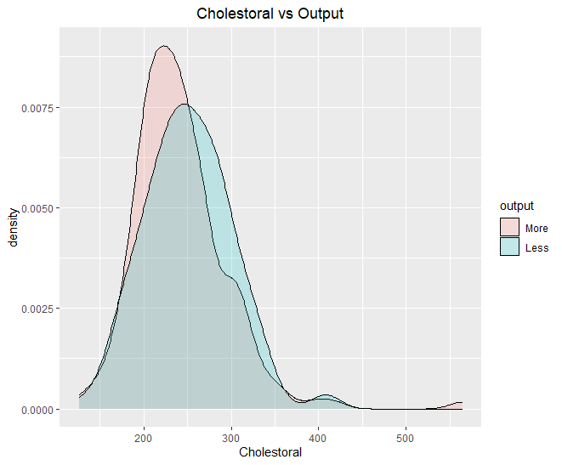
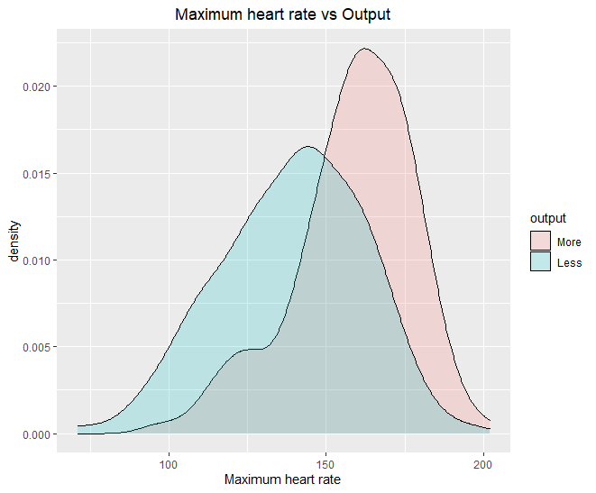
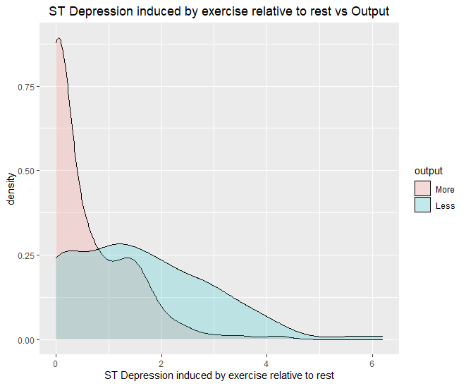
Bivariate Analysis
9

Slide 11
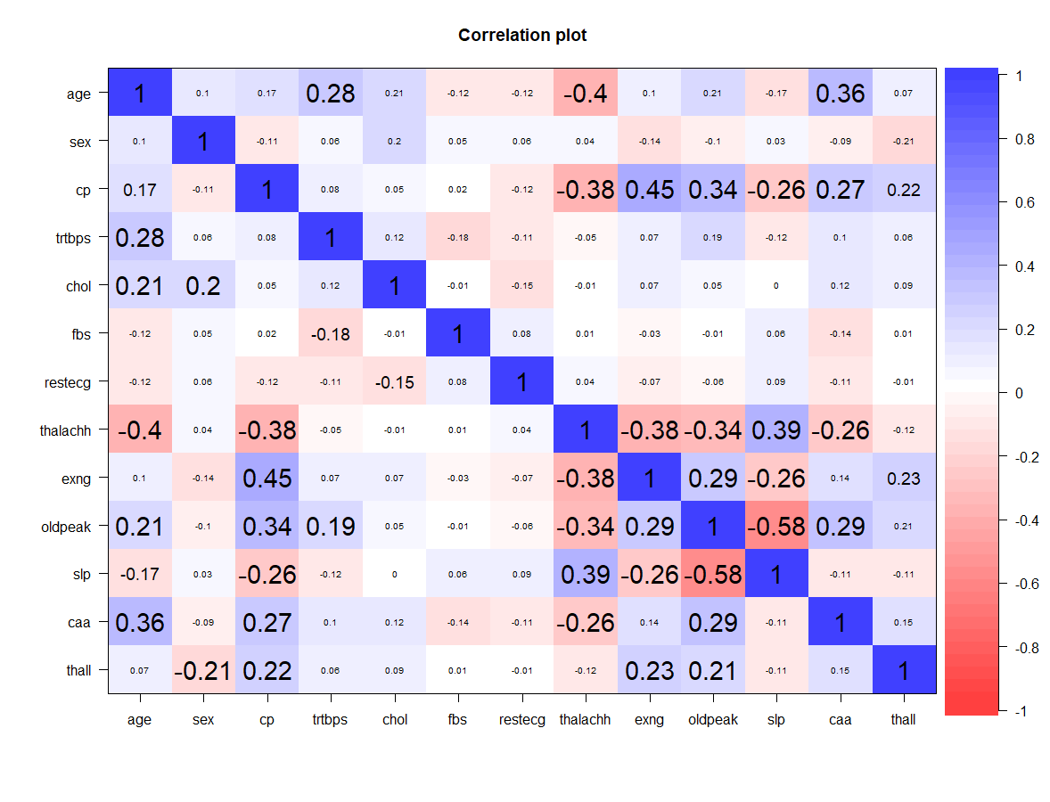
Multivariate Analysis
11

Slide 12
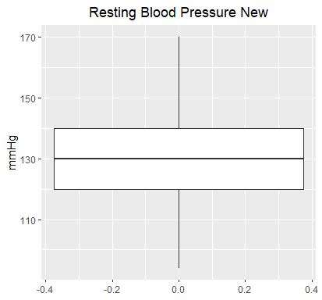
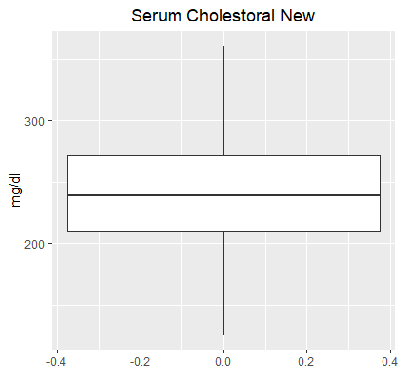
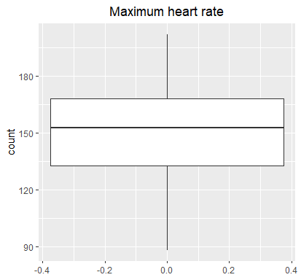
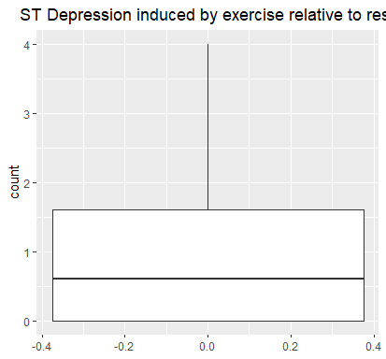
Data Preparation
Get outliers and remave value in variable
303 data observer
14 variable
Data Cleaning
284 data observer
14 variable
12

Slide 13
Data Preparation
Remove Row with Missing Value (NA Value)
284 data observer
14 variable
277data observer
14 variable
Data Cleaning
13

Slide 14
MODELING
 | Logistic Regression | Decision Tree | Random Forest | Support Vector Machine
Confusion Matrix
Result | Accuracy = 0.250 Precision = 0.323 Recall = 0.192 F1 Score = 0.241 | Accuracy = 0.726 Precision = 0.730 Recall = 0.885 F1 Score = 0.800 | Accuracy = 0.786 Precision = 0.815 Recall = 0.846 F1 Score = 0.830 | Accuracy = 0.750 Precision = 0.804 Recall = 0.788 F1 Score = 0.796
Set.Seed (2021)
Train test = 70:30
15

Slide 15
Recomendation
Random Forest algorithm the best among all the tested algorithms with precision 84,6%
However, the accuracy rate is only about 78.6% for the four algorithms used
The result can be improved by better data preparation ot using other algorithms
16

Slide 16

THANKS!
Does anyone have any questions

